Slide 1
Web Programming Fundamentals
February 2019
These slides are based on Victoria Kirst (vrk@stanford.edu) course CS193X. You can equally check out here (https://cs193x.stanford.edu) for the original course materials

Slide 2
Today's schedule
Syllabus
Course Info
Browsers! The Internet!
A little bit about HTML and CSS
Homework 0 assigned
Check out the course website for all this and more: https://webdevcg.herokuapp.com/

Slide 3



Sponsors
Kumasi Hive
Creativity Group
UENR
CSITSA

Slide 4
Syllabus

Slide 5
What is WPF?
Web Programming "Fundamentals"
- An introduction to web programming
Q: What does that mean, exactly?

Slide 6
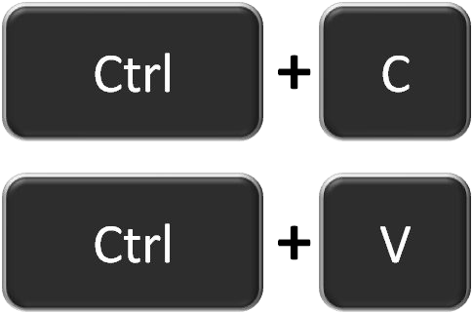

Who are you?
You are:
A copy/paste programmer of JavaScript, HTML, CSS
(or you've never used these languages)
A good programmer in at least one real* programming language
(Java, C++, etc)
Frustrated
(maybe)
*In case it's unclear, I'm being facetious

Slide 7


Frustrated?
Every beginner CSS tutorial makes CSS look trivially easy:
body {
background-color: red;
}
But then when you try to write CSS, literally nothing works:

Slide 8

Frustrated?
You want to learn JavaScript...
...but you're overwhelmed by all the frameworks, libraries, tools, etc and have no idea where to start.

Slide 9
What is this course about?
Opinionated:
There are many ways to do things on the web: can't learn them all at once!
What I think you need to know as a beginner
Hopefully frustration-free:
We will go slowly through the essential concepts and speed through the obvious stuff
You are not expected to fill in the gaps via Google and StackOverflow

Slide 10
Goals
If you never take another web programming class again, you will leave this course with the following skills:
Create attractive, small scale web sites or apps that at least mostly work on phones
Have the vocabulary and background knowledge to understand technical writing/discussions about the web
(e.g. web API documentation; random blog posts)
Have the foundation to pursue the areas of web programming that you're interested in (if you choose)

Slide 11
in detail
HTML
CSS
JavaScript
Backend basics
Server on NodeJS + Express
Database via MongoDb and Mongoose
(Uh…)

Slide 12
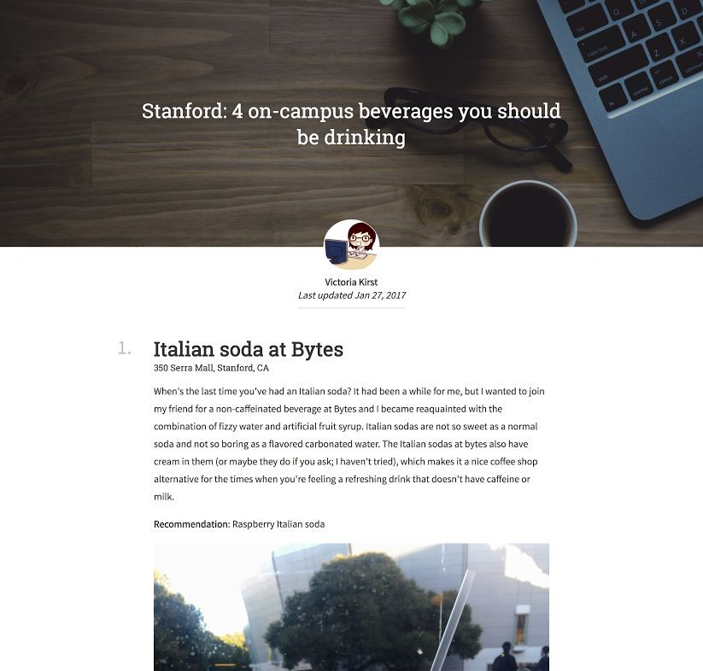
CSS, applied
HW1 will ask you to make a webpage that looks like this-ish:
(Note: HW1 is not released yet.)

Slide 13
CSS
HTML (~1 day)
Key concepts: inline, block, inline-block
CSS (~1.5 weeks)
Multiple rendering styles: natural, flex, positioned, float
Mobile layouts
Transforms and animations
- FYI: No libraries or compiled CSS

Slide 14
Modern JS / ES6+
Later in the quarter, we will read and write JavaScript that looks sort of like this:
(async () => {
let choice = 'e'; do {
choice = await askQuestion('Enter choice');
await processChoice(choice);
} while (choice != 'e');
})();

Slide 15
Modern JS / ES6+
JavaScript (~5 weeks)
JavaScript classes
Relevant functional programming
Lambdas
Generator functions and async/await
"Fat arrow" vs function
Closures
Creating and using Promises
Understanding the Event Loop
Modules and encapsulation
NO frontend framework; minimal libraries
No Angular/React/JQuery/etc

Slide 16

JavaScript, applied
HW2 will ask you to make a webpage that looks like this-ish:

Slide 17
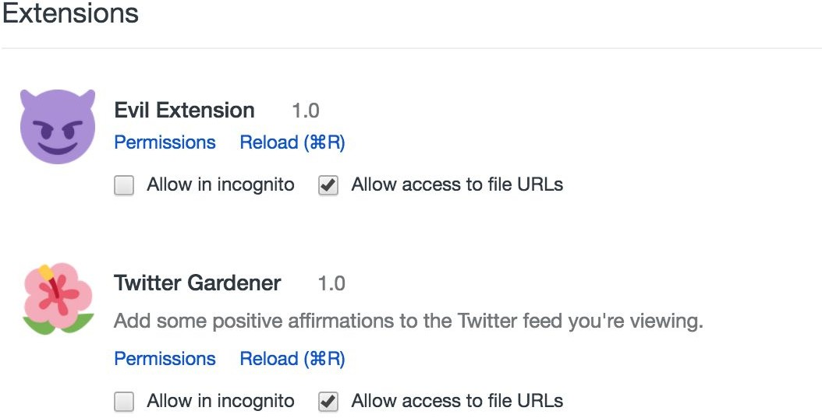
JavaScript, applied
And HW2 will also ask you to write two small Chrome extensions:
(Note: HW2 is also not
released yet.)

Slide 18
Baby's first backend
coverage of server-side programming will be light.
Backend stack:
NodeJS + Express + MongoDB via Mongoose (~3 weeks)
What is a server
What is npm
How to serve static web pages
How to server JSON via REST APIs
Writing to and loading from a database
Authentication via OAuth2 (i.e. login via Gmail account)

Slide 19

Structure
"Homework 0" + 6 homeworks
Each homework will be a standalone web page or a very small standalone web app
Each homework with have a multiple choice "mini-homework" attached to it
- Individual assignments; pairing allowed
1 final project
Open-ended! Details to come.
~1 week in scope
Individual project; groups allowed

Slide 20
Course info

Slide 21
Disclaimer
This is the second ever offering of this course , meaning:
- Everything is subject to change. Including everything I've just told you and everything I'm about to tell you.
There will be all the mistakes of a new course!
Bugs in homework
Awkward lectures
Things that are too hard / too easy
Please be patient with us! We are also soliciting your constructive feedback.

Slide 22
Browser and Text editor/IDE
Text editor: You can use whatever you want. We recommend Visual studio code.
Browser: Your code must work on Chrome, as that is what your TAs will use when grading your homework. It will not be tested in any other browser.
- Homework turn-in: We are using GitHub

Slide 23
Questions?

Slide 24
Today's schedule
Syllabus
Course Info
Browsers! The Internet!
A little bit about HTML and CSS

Slide 25
Browsers! The Internet! The web!

Slide 26
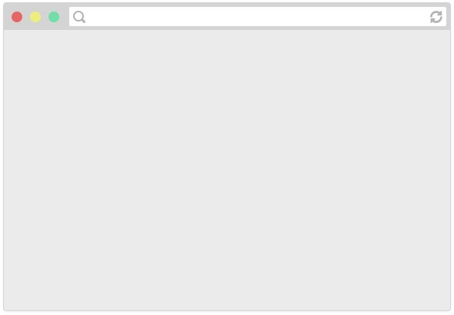
How do web pages work?
Browsers are applications that can display web pages.
E.g. Chrome, Firefox, Safari, Internet Explorer, Edge, etc.

Slide 27

How do web pages work?
Web pages are written in a markup language called HTML, so browsers display a web page by reading and interpreting its HTML.

Slide 28
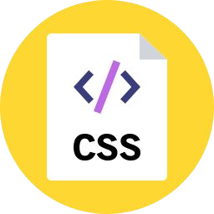


How do web pages work?
The HTML file might link to other resources, like images, videos, as well as JavaScript and CSS (stylesheet) files, which the browser then also loads.

Slide 29

How do web pages work?
A web server is a program running on a computer that delivers web pages in response to requests.
It either stores or generates the web page returned.

Slide 30
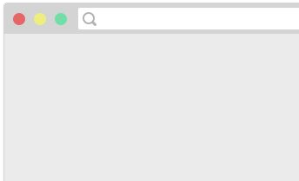
How do web pages work?
webdevcg.herokuapp.com
1. You type in a URL,
which is the address of the HTML file on the internet.

Slide 31
How do web pages work?
2. The browser asks the web server that
hosts the document to send that document.
GET

Slide 32
How do web pages work?
3. The web server responds to the
browser with HTML file that was requested.
OK

Slide 33

How do web pages work?
4. The browser reads the HTML, sees the embedded resources and asks the server for
those as well.
GET
OK
...
GET
OK

Slide 34
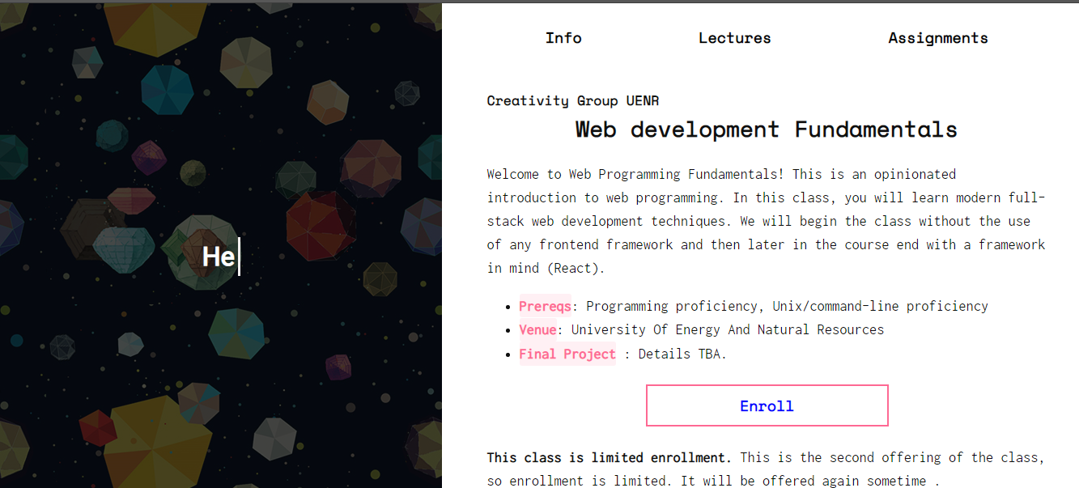
How do web pages work?
5. The web page is loaded when all the resources are fetched and displayed.
webdevcg.herokuapp.com/

Slide 35
P.S.
(That was obviously very hand-wavy. We'll get more detailed when we talk about servers later in the quarter.)
webdevcg.herokuapp.com/

Slide 36
HTML and CSS

Slide 37
HTML and CSS strategy
Assumption: Most people have cursory familiarity with HTML and CSS. Therefore we will:
Speed through the obvious stuff
Skip self-explanatory syntax
Skip the parts you can look up easily through Google
Therefore, be aggressive with questions!

Slide 38
What is HTML?
HTML (Hypertext Markup Language)
Describes the content and structure of a web page; not a programming language.
Made up of building blocks called elements.
<p>
HTML is <em>awesome!!!</em>
<img src="puppy.png" />
</p>

Slide 39
Basic HTML page structure
(i.e. copy/paste boilerplate)
<!DOCTYPE html>
<html>
<head>
<title>CS 193X</title>
</head>
<body>
... contents of the page...
</body>
</html>
Saved in a filename.html file.

Slide 40
Basic HTML page structure
(i.e. copy/paste boilerplate)
<!DOCTYPE html>
<html>
<head>
<title>CS 193X</title>
</head>
Metadata that doesn't appear in the viewport of the browser
E.g. <title> shows up as the name of the tab
<body>
... contents of the page...
</body>
</html>
Contents that render in the viewport of the browser

Slide 41
HTML elements
<p>
HTML is <em>awesome!!!</em>
<img src="puppy.png" />
</p>
An element usually has start and ending tags (<p> and </p>)
content: stuff in between start and end tags
An element can be self-closing (img)
An element can have attributes (src="puppy.jpg")
Elements can contain other elements (p contains em and img)

Slide 42
Some HTML elements
(to place within <body>)
Top-level heading h1, h2, ... h6 | <h1>Moby Dick</h1>
Paragraph | <p>Call me Ishmael.</p>
Line break | since feeling is first<br/> who pays any attention
Image | <img src="cover.png" />
Link | <a href="google.com">click here!</a>
Strong (bold) | <strong>Be BOLD</strong>
Emphasis (italic) | He's my <em>brother</em> and all

Slide 43
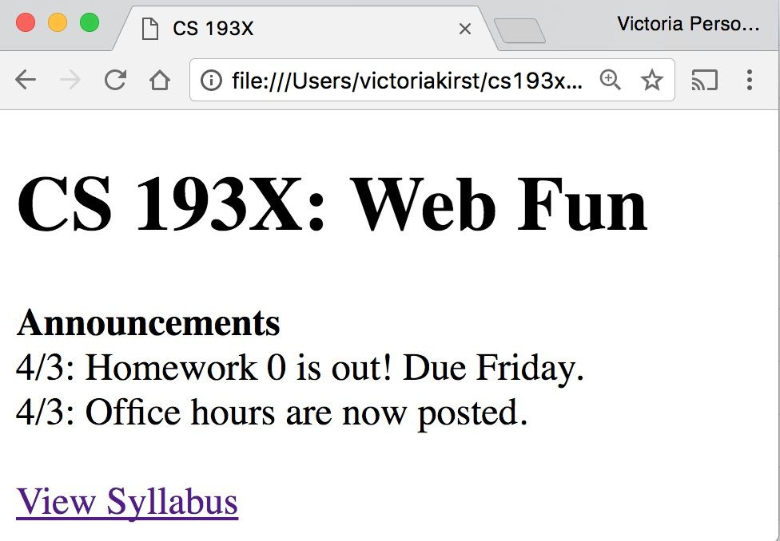
Exercise: Course web page
Let's write some HTML to make the following page:

Slide 44
Exercise: Course web page
HTML boilerplate
Plaintext contents of the page
<!DOCTYPE html>
<html>
<head>
<title>CS 193X</title>
</head>
<body>
...
</body>
</html>
CS 193X: Web Fun
Announcements
4/3: Homework 0 is out! Due Friday.
4/3: Office hours are now posted.
View Syllabus
JSBin

Slide 45
Solution
<!DOCTYPE html>
<html>
<head>
<title>CS 193X</title>
</head>
<body>
<h1>CS 193X: Web Fun</h1>
<strong>Announcements</strong><br/> 4/3: Homework 0 is out!<br/>
4/3: Office hours are now posted.<br/>
<br/>
<a href="http://cs193x.stanford.edu/syllabus"> View Syllabus
</a>
</body>
</html>

Slide 46
That was weird
- We saw that HTML whitespace collapses into one space…
<h1>CS 193X: Web Fun</h1>
<strong>Announcements</strong><br/>
4/3: Homework 0 is out!<br/>
- Except weirdly the <h1> heading was on a line of its own, and <strong> was not.
Hmmm… strange…
Oh well, it works! Let's move on!!!

Slide 47
CSS

Slide 48
CSS
CSS: Cascading Style Sheets
Describes the appearance and layout of a web page
Composed of CSS rules, which define sets of styles
selector {
property: value;
}

Slide 49
CSS
A CSS file is composed of style rules:
selector {
property: value;
}
selector: Specifies the HTML element(s) to style.
property: The name of the CSS style.
value: The value for the CSS style.
Saved in a filename.css file.

Slide 50

// NOT REAL CSS
fork {
CSS
color: gold;
}
"All forks on the table should be gold"

Slide 51
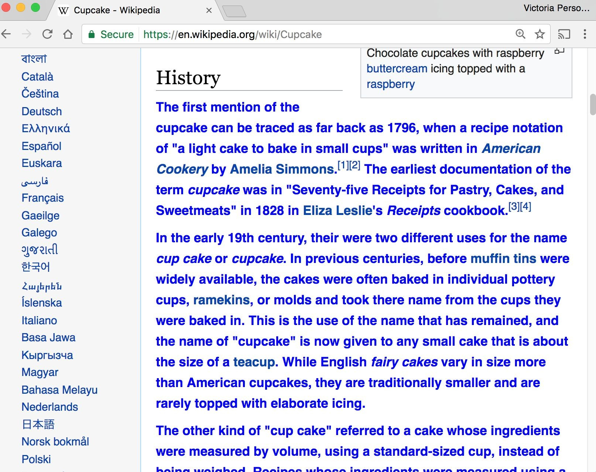
CSS
p {
color: blue;
font-weight: bold;
}
"All <p> elements on the page should be blue and bold"

Slide 52
Linking CSS in HTML
(i.e. copy/paste boilerplate)
<!DOCTYPE html>
<html>
<head>
<title>CS 193X</title>
<link rel="stylesheet" href="filename.css" />
</head>
<body>
... contents of the page...
</body>
</html>

Slide 53
Some CSS properties
There are over 500 CSS properties! Here are a few:
Font face (mdn) | font-family: Helvetica;
Font color (mdn) | color: gray;
Background color (mdn) | background-color: red;
Border (mdn) | border: 3px solid green;
Text alignment (mdn) | text-align: center;
Aside: Mozilla Developer Network (MDN) is the best reference for HTML elements and CSS properties
- The actual W3 spec is very hard to read (meant for browser developers, not web developers)

Slide 54
Main ways to define CSS colors:
140 predefined names (list)
color: black;
Hex values
color: #00ff00; color: #0f0; color: #00ff0080;
rgb() and rgba()
color: rgb(34, 12, 64);
color: rgba(0, 0, 0, 0.5);
The "a" stands for alpha channel and is a transparency value
Generally prefer more descriptive over less:
Predefined name
rgb / rgba
Hex

Slide 55
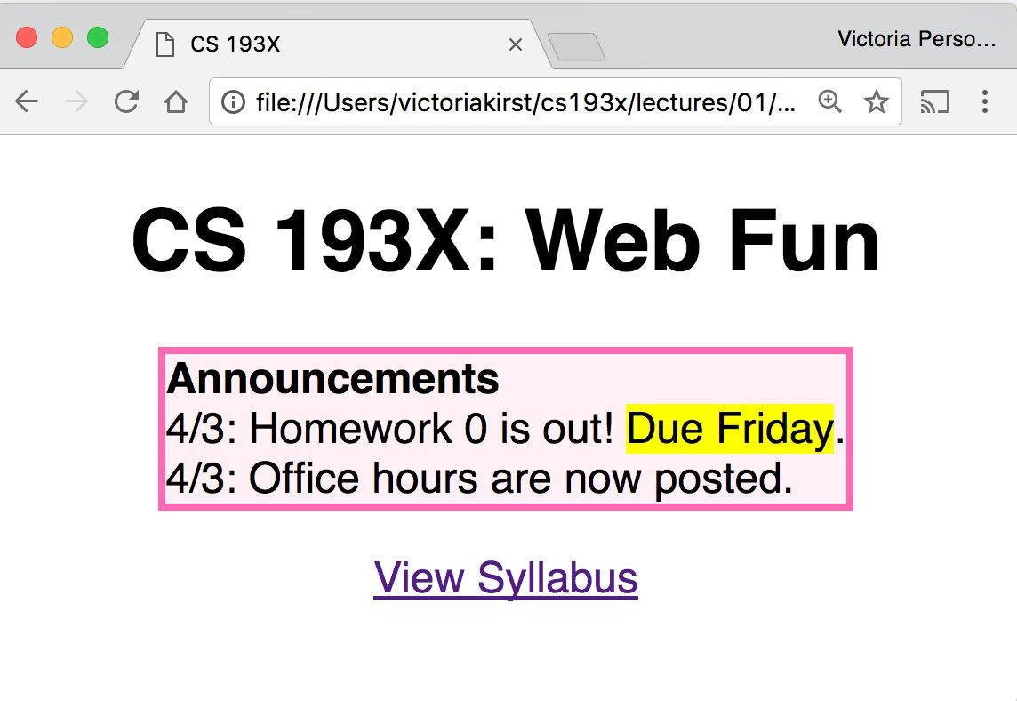
Exercise: Course web page
Let's write some CSS to style our page:

Slide 56
Exercise: Course web page
Let's write some CSS to style our page:
Font face: Helvetica
Border: hotpink 3px Background color: lavenderblush Highlight: yellow
Box is centered
Header and link are
centered
Box contents are
left-aligned
JSBin

Slide 57
CSS exercise debrief
Some key techniques:
Add invisible containers in HTML to select groups of elements in CSS.
Apply styles to parent / ancestor element to style parent and all its children. (Will talk more about this later.)
But we encountered more weirdness...
Couldn't set text-align: center; to the <a> or
<strong> tags directly, but could center <p> and <h1>
Had to set a width on the box to make it hug the text …
any other way to do this?
How to center the box?! How do you highlight?!

Slide 58
Q: Why is HTML/CSS so bizarre??

Slide 59
A: There is one crucial set of rules we haven't learned yet…
block vs inline display

Slide 60
Next time!
Homework 0 is
out now, due this Friday April 7

Slide 61
Overflow slides

Slide 62
Q: Why is HTML/CSS so bizarre??

Slide 63
A: There is one crucial set of rules we haven't learned yet…
block vs inline display

Slide 64
What is HTML?
HTML (Hypertext Markup Language)
Describes the content and structure of a web page
Made up of building blocks called elements.
<p>
HTML is <em>awesome!!!</em>
<img src="puppy.png" />
</p>
And there are 3 basic types.

Slide 65
Types of HTML elements
Each HTML element is categorized by the HTML spec into one of three-ish categories:
block: large blocks of content, has height and width
<p>, <h1>, <blockquote>, <ol>, <ul>, <table>
inline: small amount of content, no height or width
<a>, <em>, <strong>,<br>
inline block: inline content with height and width
<img>
metadata: information about the page, usually not visible
<title>, <meta>

Slide 66
Block elements
Examples:
<p>, <h1>, <blockquote>, <ol>, <ul>, <table>
Take up the full width of the page (flows top to bottom)
Have a height and
width
Can have block or inline elements as children

Slide 67
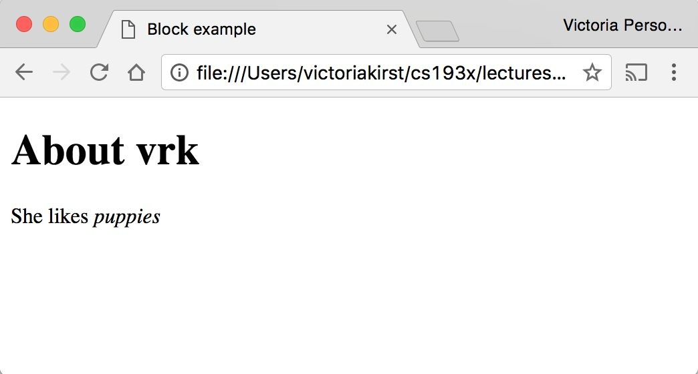
Example: Block
 | <h1>About vrk</h1> <p> She likes <em>puppies</em>
 | </p>

Slide 68
Q: What does this look like in the
browser?
h1 {
border: 5px solid red;
}
 | <h1>About vrk</h1> <p> She likes <em>puppies</e | m>
 | </p>

Slide 69
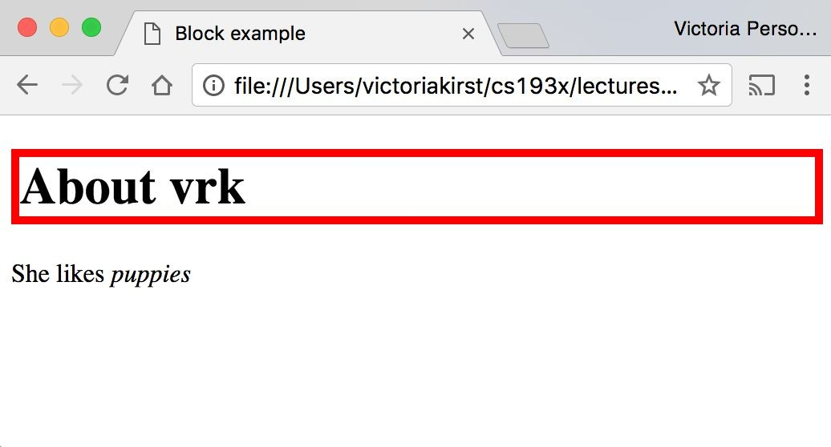

Slide 70
Block-level:
extends the full width of the page
h1 {
border: 5px solid red;
}
<h1>About vrk</h1>
<p>
She likes <em>puppies</em>
</p>
<h1> is block-level, so it extends the full width of the page by default
Note how block-level elements (h1, p) flow top to bottom
See: JSBin

Slide 71
Q: What does this look like in the
browser?
h1 {
border: 5px solid red;
width: 50%;
}
 | <h1>About vrk</h1> <p> She likes <em>puppies</em </p> | >

Slide 72
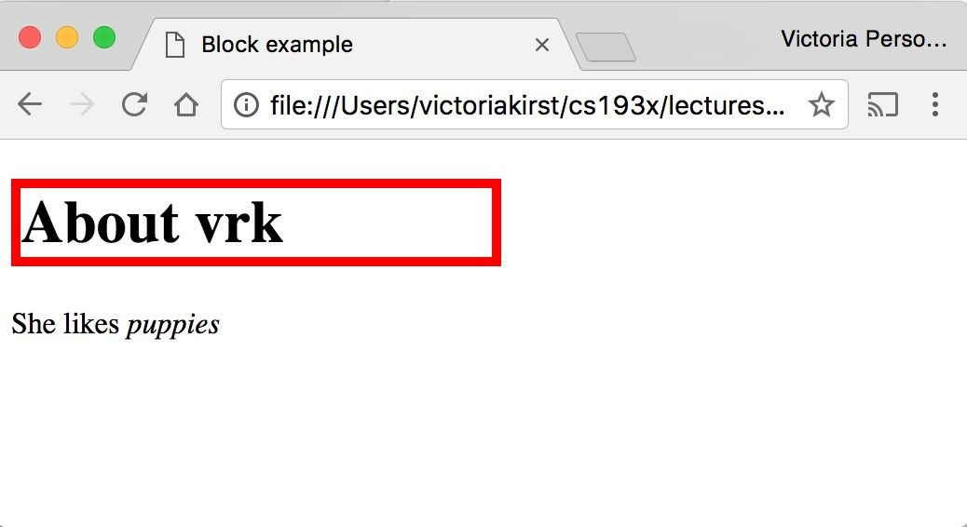

Slide 73
Block-level
width can be modified
h1 { border: 5px | solid | red; |  | <h1>About vrk</h1> <p>
width: 50%; |  |  |  | She likes <em>puppies</em>
} |  |  |  | </p>
<h1> is block-level, so its width can be modified
Block-level elements still flow top to bottom
See: JSBin

Slide 74
Inline elements
Examples:
<a>, <em>, <strong>, <br>
Take up only as much width as needed (flows left to right)
Cannot have height and width
Cannot have a block element child
Cannot be positioned (i.e. CSS properties like float and position do not apply to inline elements)
Must position its containing block element instead

Slide 75
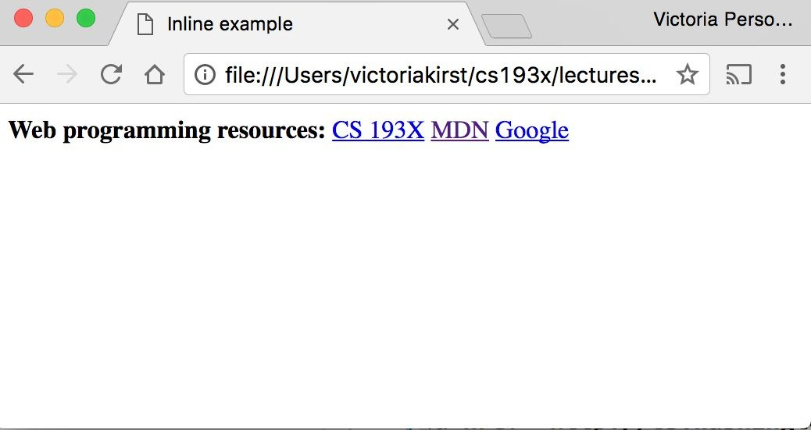
Example: Inline
< < < | strong>Web programming resources:</strong> a href="http://cs193x.stanford.edu">CS 193X</a> a href="https://developer.mozilla.org/en-US/">MDN</a>
<a href="http://google.com">Google</a>

Slide 76
Q: What does this look like in the
browser?
strong {
border: 5px solid red; width: 1000px;
}
 | strong>Web programming resources:</strong>
 | a href="http://cs193x.stanford.edu">CS 193X</a>
 | a href="https://developer.mozilla.org/en-US/">MDN</a>
 | a href="http://google.com">Google</a>

Slide 77
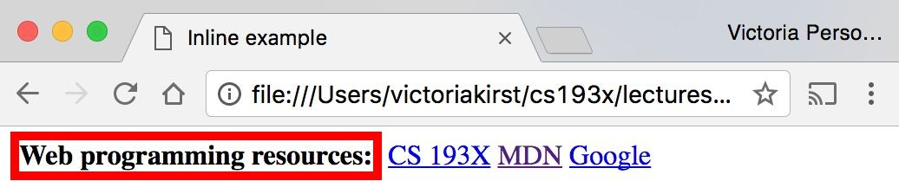

Slide 78
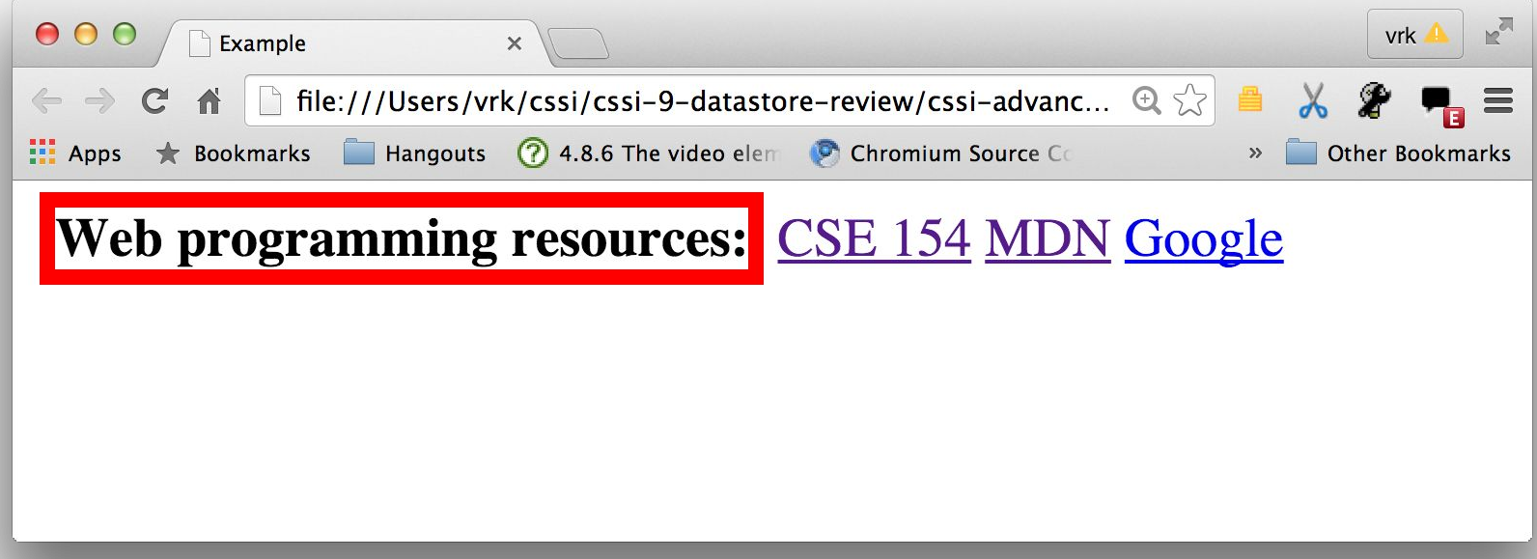
Inline elements ignore width
width cannot be modified
strong {
border: 5px solid red;
width: 1000px;
/* Will not work; strong is inline! */
}
<strong>Web programming reso
<a href="http://cs193x.stanf
<a href="https://developer.m
<a href="http://google.com">
Cannot set width on inline element, so it is ignored (JSBin)

Slide 79
inline-block
Examples: <img>, any element with
display: inline-block;
Take up only as much width as needed (flows left to right)
Can have height and width
Can have a block element as a child
Can be positioned (i.e. CSS properties like float and position apply)

Slide 80

Example: Inline-block
img {
width: 50px;
}
Q: What does this look like in the browser?
<img | src="http://i.imgur.com/WJToVGv.jpg" | />
<img | src="http://i.imgur.com/WJToVGv.jpg" | />
<img | src="http://i.imgur.com/WJToVGv.jpg" | />
<img | src="http://i.imgur.com/WJToVGv.jpg" | />
<img | src="http://i.imgur.com/WJToVGv.jpg" | />
http://i.imgur.com/WJToVGv.jpg =

Slide 81
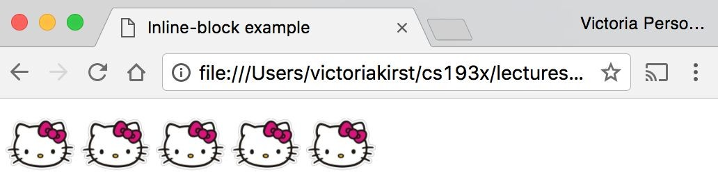

Slide 82
Inline-block
Has width and height; flows left to right
Can set width on inline-block element, so image width is set to 50px. (JSBin)
inline-block flows left to right, so images are right next to each other.
<img | src="http://i.imgur.com/WJToVGv.jpg" | />
<img | src="http://i.imgur.com/WJToVGv.jpg" | />
<img | src="http://i.imgur.com/WJToVGv.jpg" | />
<img | src="http://i.imgur.com/WJToVGv.jpg" | />
<img | src="http://i.imgur.com/WJToVGv.jpg" | />
img {
width: 50px;
}

Slide 83
The display CSS property
You can change an element's default rendering type by changing the display property. Examples:
p {
display: inline;
}
a {
display: block;
}
Possible values for display:
block
inline
inline-block
- some others: link

Slide 84
Review
block: flows top-to-bottom; has height and width
<p>, <h1>, <blockquote>, <ol>, <ul>, <table>
inline: flows left-to-right; does not have height and width
<a>, <em>, <strong>,<br>
inline block: flows left-to-right; has height and width
<img>
Questions?

Slide 85
Moral of the story:
If your CSS isn't working, see if you're trying to apply block-level properties to inline elements

Slide 86
Extra slides
1. The course is adopted from vrkirst’s lectures on Web Programming class. You can check the original page at http://cs193x.stanford.edu for the original course materials.
2. https://www.youtube.com/watch?v=Dxcc6ycZ73M
3. https://www.techopedia.com/definition/2419/internet
4. https://www.theguardian.com/technology/2018/oct/22/what-is-the-internet-13-key-questions-answered
5. https://medium.freecodecamp.org/whats-the-document-object-model-and-why-you-should-know-how-to-use-it-1a2d0bc5429d

